Slide 1


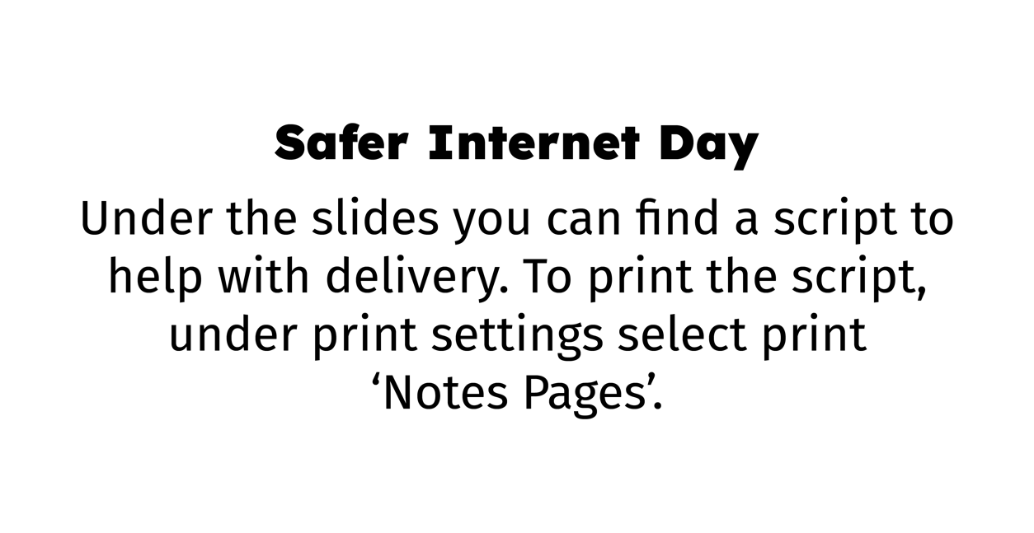

Slide 2
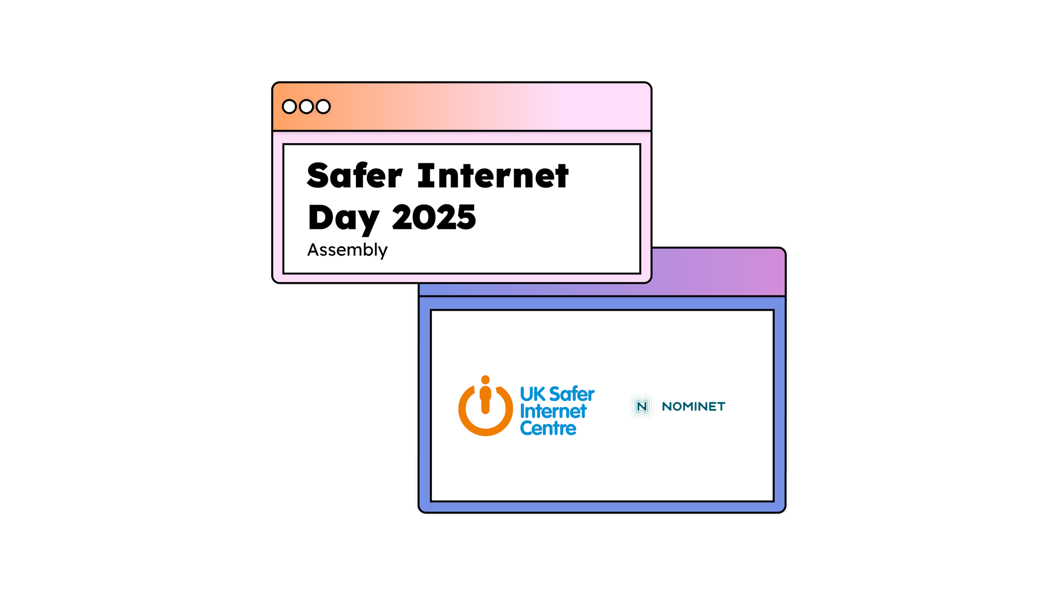



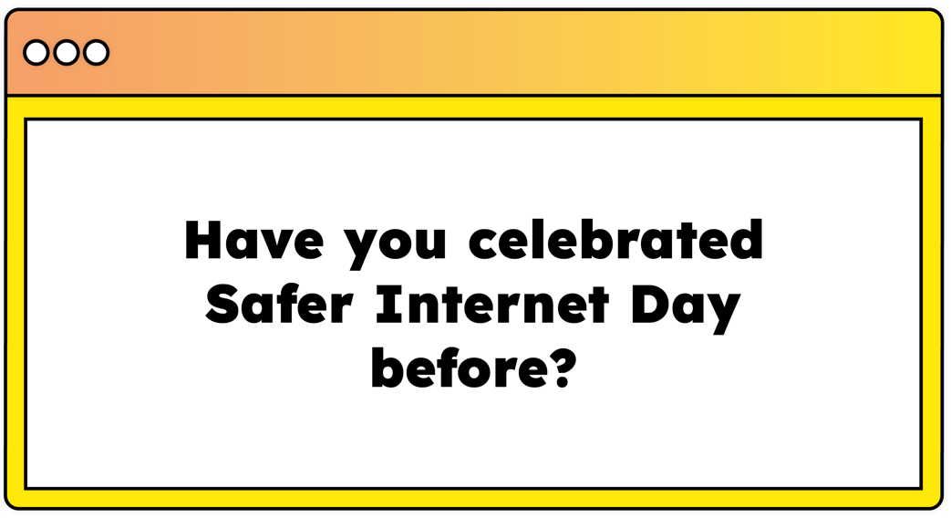
Notes:
Hello everyone. In today’s assembly we’re going to be talking about Safer Internet Day. Have you celebrated Safer Internet Day before? What do you think Safer Internet Day is about?

Slide 3
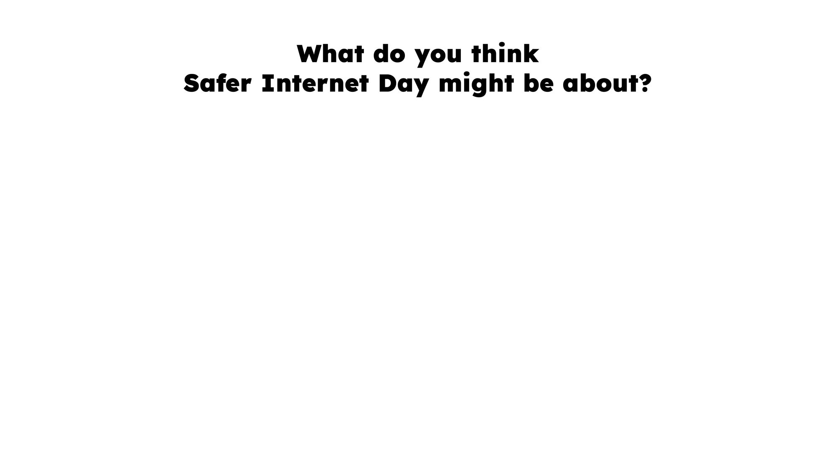

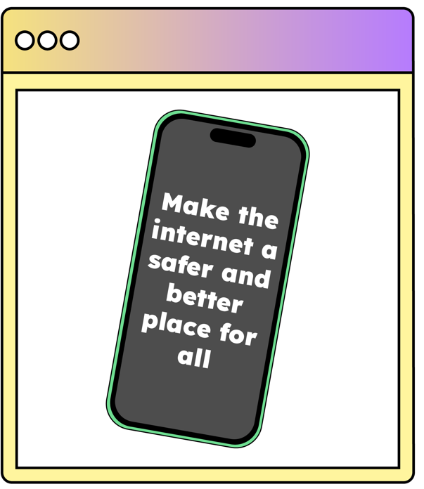
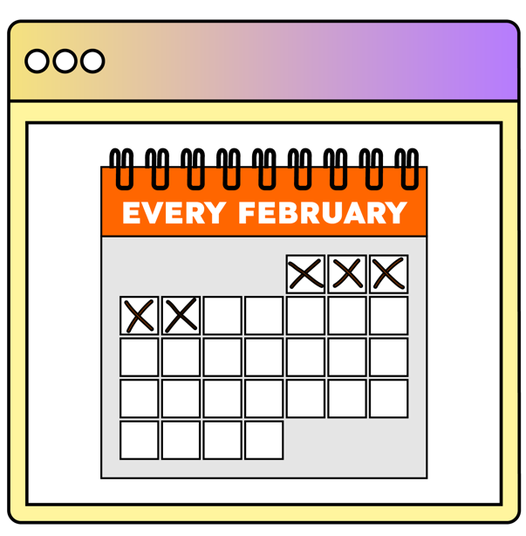

Notes:
Safer Internet Day is held every February all around the world. Last year, over 170 different countries celebrated the day! Safer Internet Day is a chance to think about any worries we might have about using technology and the internet, but it’s also about celebrating all the fantastic things technology can help us with. Last year, over half of the children in the UK heard about or joined in with Safer Internet Day.

Slide 4


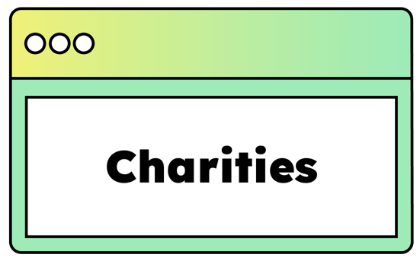



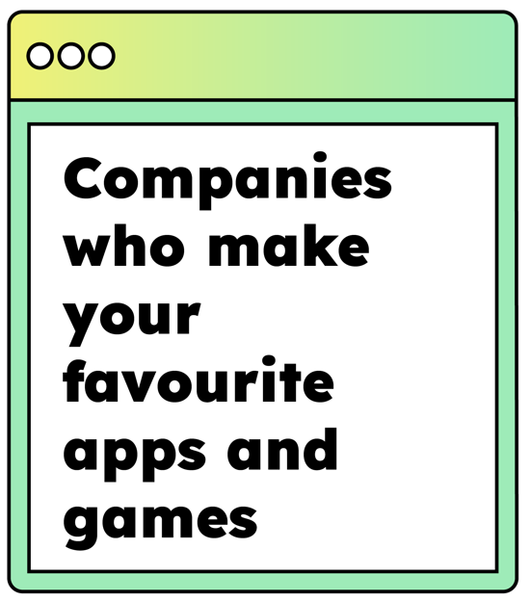

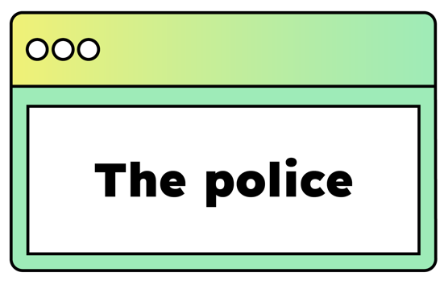
Notes:
And it’s not just schools who join in with the day, lots of other people get involved too, including the government, lots of charities, sports clubs, the police and even the companies who make your favourite apps and games. By participating in this assembly, you’re joining thousands of others in celebrating the day!

Slide 5
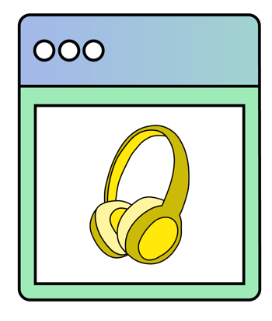



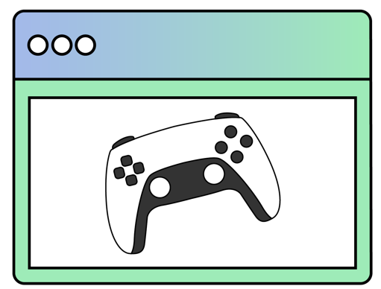

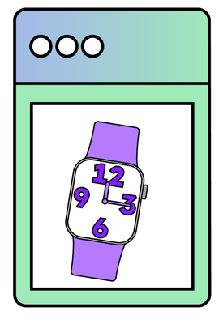
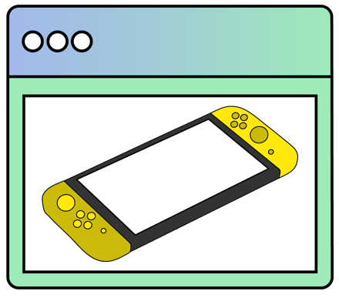
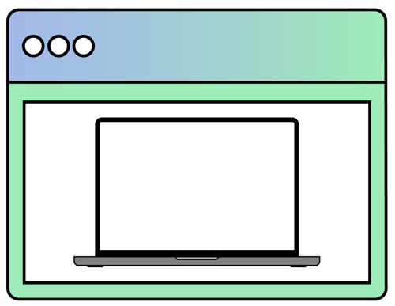

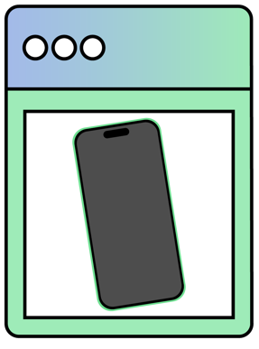
Notes:
We want this year’s Safer Internet Day to be the biggest and best celebration yet! It’s so important to recognise all the exciting and amazing things we can do online… maybe you like to play games, or chat with your friends. Maybe you use the internet to learn new things, or maybe you love watching videos. What’s your favourite thing to do online or using technology? [Take responses from learners.]

Slide 6
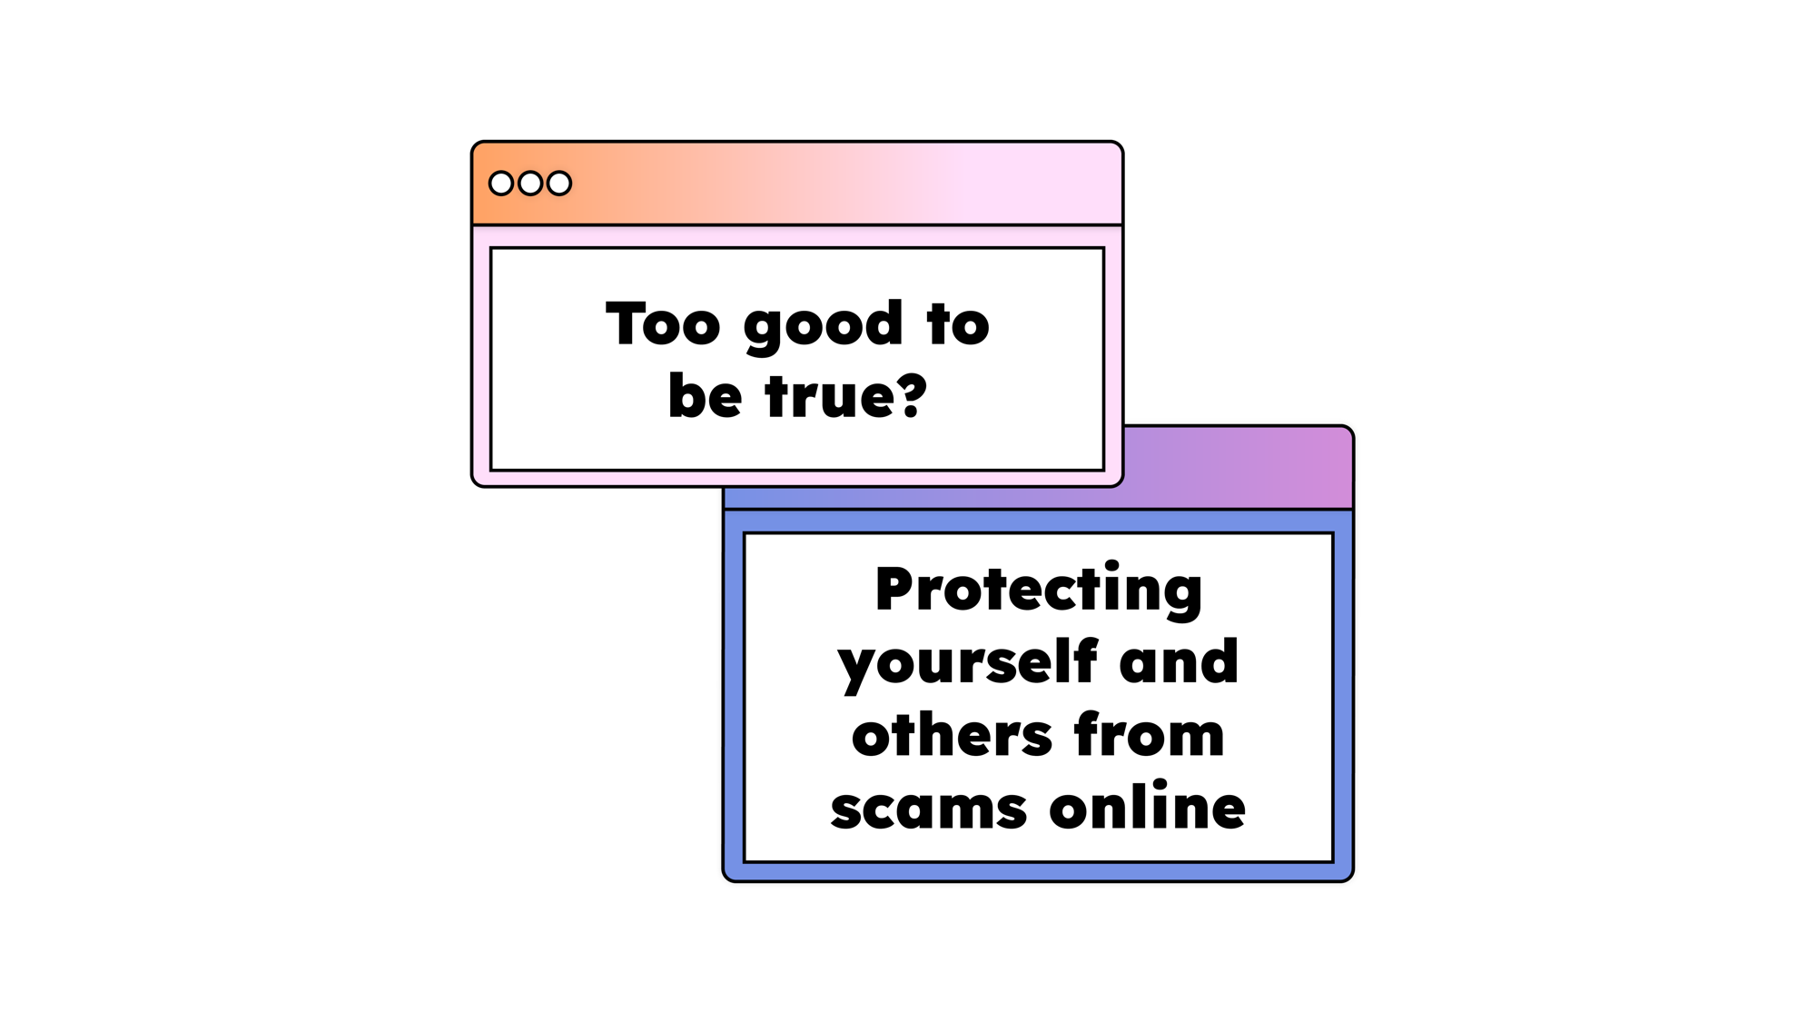


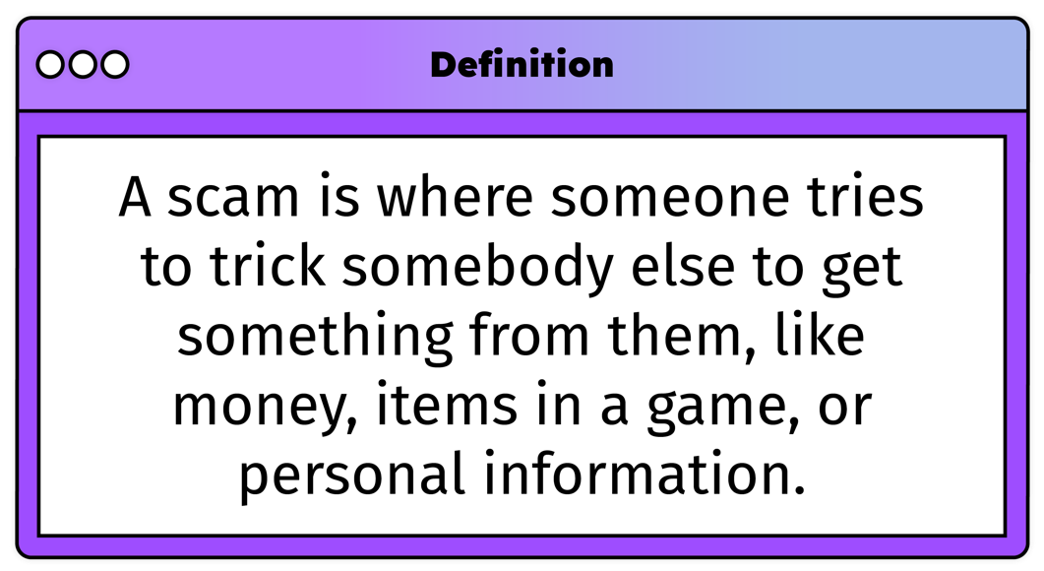
Notes:
This year for Safer Internet Day we are thinking about an important issue: online scams. Who can explain what a scam is?
[Take responses from learners.]
Great answers everyone – a scam is where someone tries to trick somebody else to get something from them, like money, items in a game, or personal information. Scams can happen online when we’re using technology, like a phone or a tablet, and offline, when we meet people face to face.

Slide 7
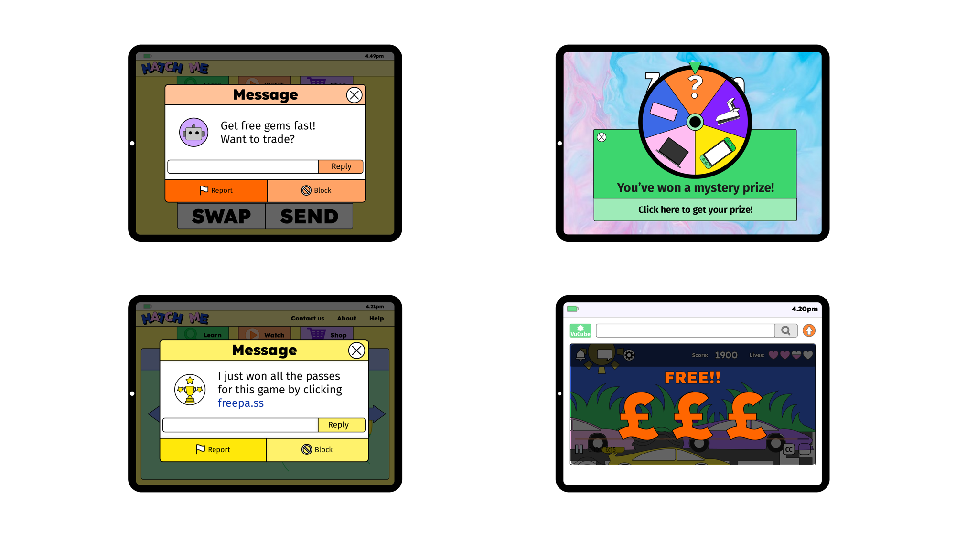


Notes:
There are lots of types of scams online – perhaps you have seen some before.
Put your hand up if you have seen…
a message or an email with a suspicious looking link
something that seems too good to be true, like you’ve won a prize
another player in a game agreeing to trade but then taking something and not giving anything in return
a video, app, advert or website that says it can show you how to get free money in your favourite game

Slide 8







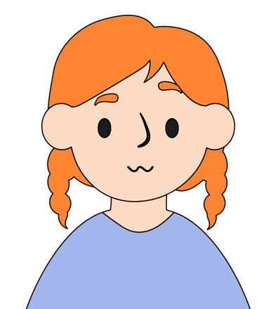
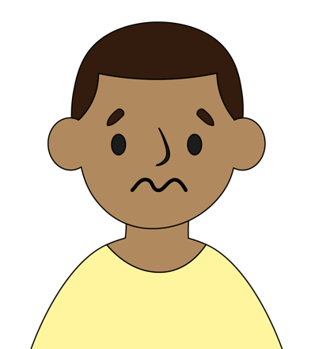
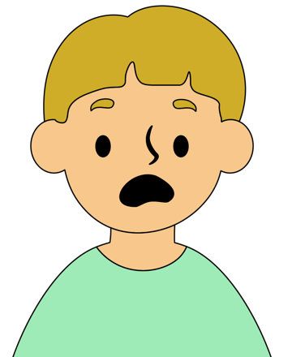

Notes:
Seeing these things can make us feel different emotions. We might feel…
excited or curious by a tempting offer
nervous or worried if we feel unsure
upset or angry if someone tricks us online
alone or embarrassed if we’ve been targeted by a scam
Being scammed can happen to anybody and it’s not your fault if you’ve been tricked by something online. It’s normal to feel a mix of emotions when you’re online, but remember that you’re not on your own. There are always ways to make things better, even after being targeted by a scam.

Slide 9

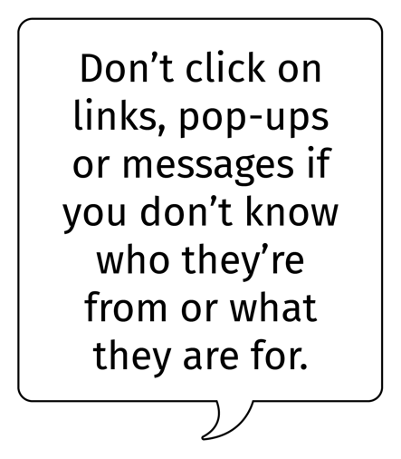
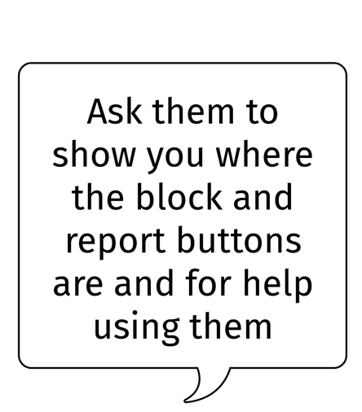
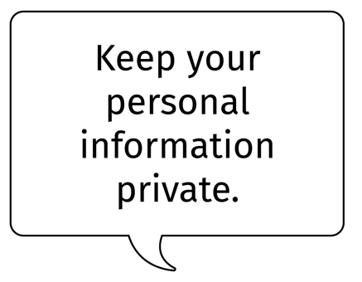
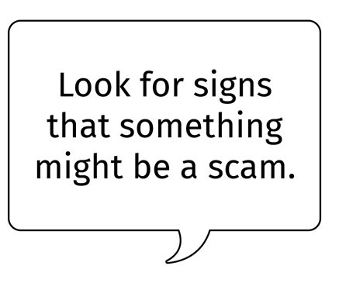
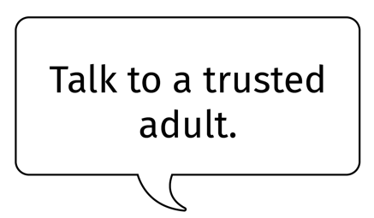

Notes:
It’s important that everyone feels safe when they are using technology. How can you stay safe even if you see a scam online?
[Take responses from learners and click to reveal answers.]
Look for signs that something might be a scam. Does it seem too good to be true?
Keep your personal information, like your name, school, email, phone or bank details safe and private.
Don’t click on links, pop-ups or messages if you don’t know who they’re from or what they are for.
Talk to a trusted adult, especially if you are worried, upset or unsure.
Ask them to show you where the block and report buttons are and for help using them.
If you have been scammed, it’s never too late to talk to a trusted adult and get some help.

Slide 10







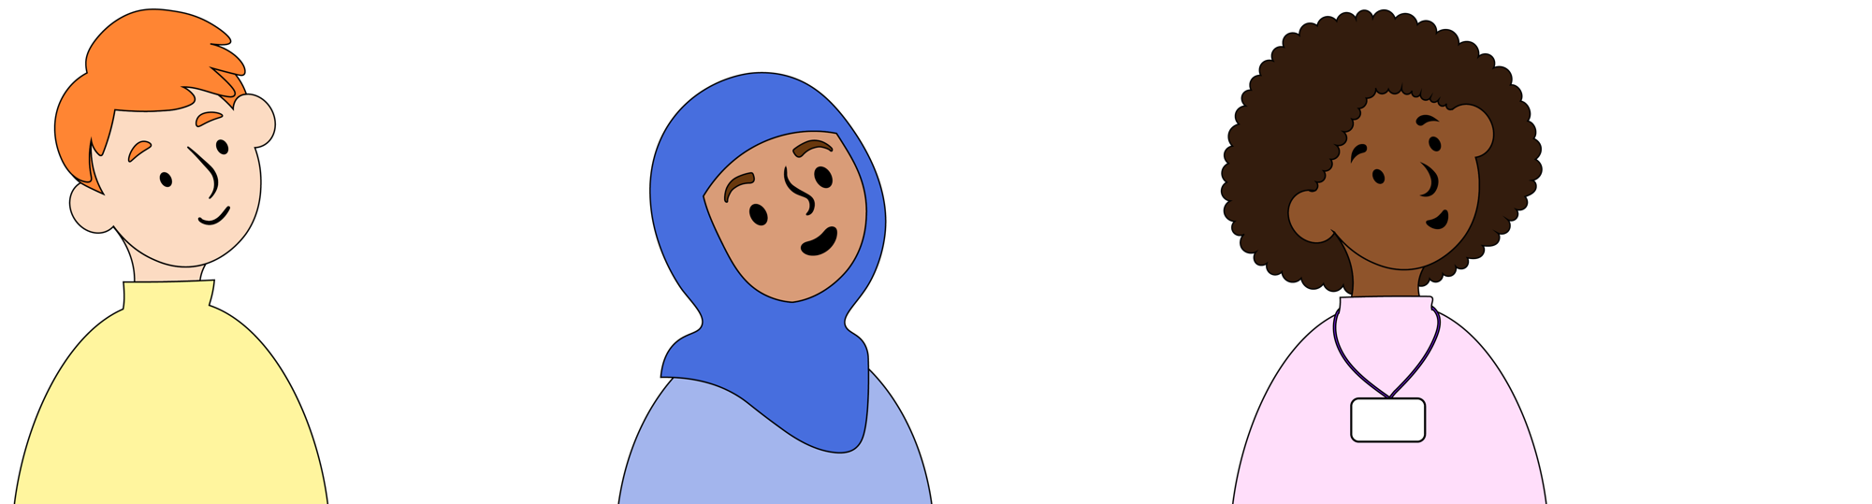
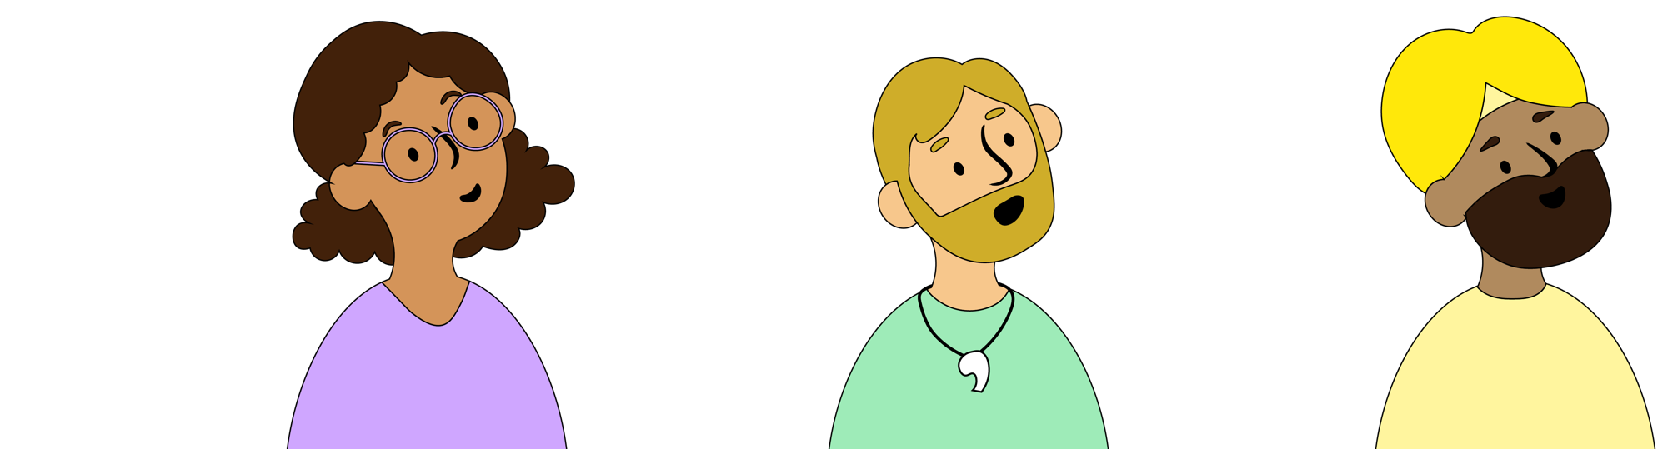
Notes:
Who are the trusted adults you could talk to about things online?
[Take answers then display on screen]
Parents or carers
Grandparents
Aunties and Uncles
Sports club leader
Teachers and teaching assistants
It’s really important to tell a trusted adult if something happens online that worries or upsets you.

Slide 11


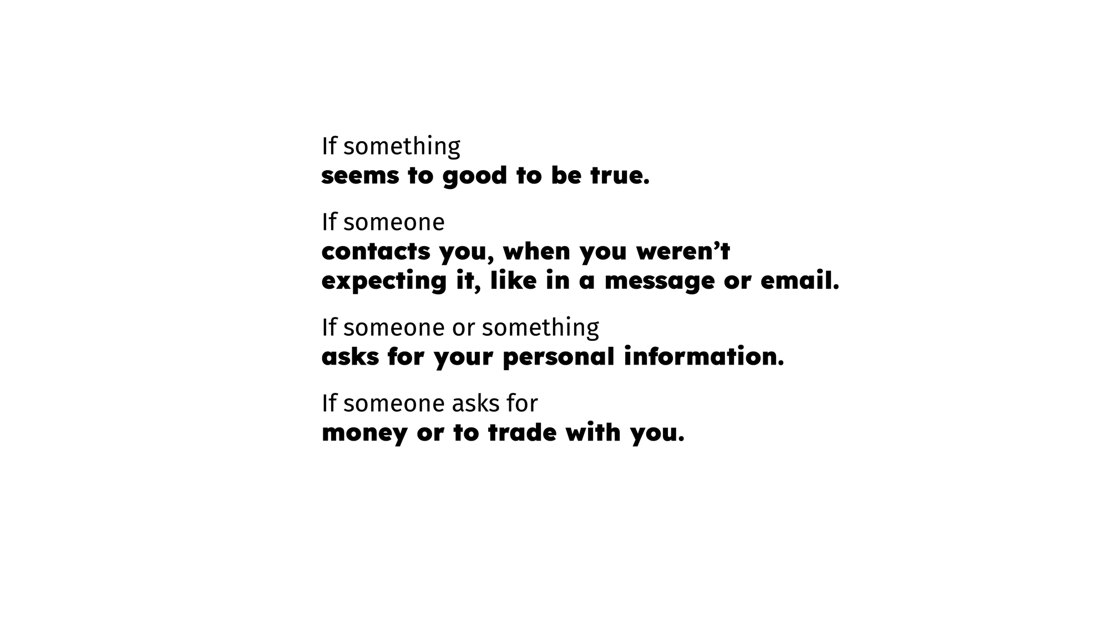

Notes:
Let’s finish by looking at this clever way to spot the signs of a scam!
If something seems too good to be true, like a high quality item for a very cheap price.
If someone contacts you when you weren’t expecting it, like in a message or email.
If someone or something asks for your personal information.
If someone asks for money or to trade with you.
What do all of these spell out?
[Take responses from learners]
That’s right – SCAM.
I know lots of you are really good at spotting scams – maybe you can use what we’ve talked about today to help teach other people how to keep themselves safe online.

Slide 12


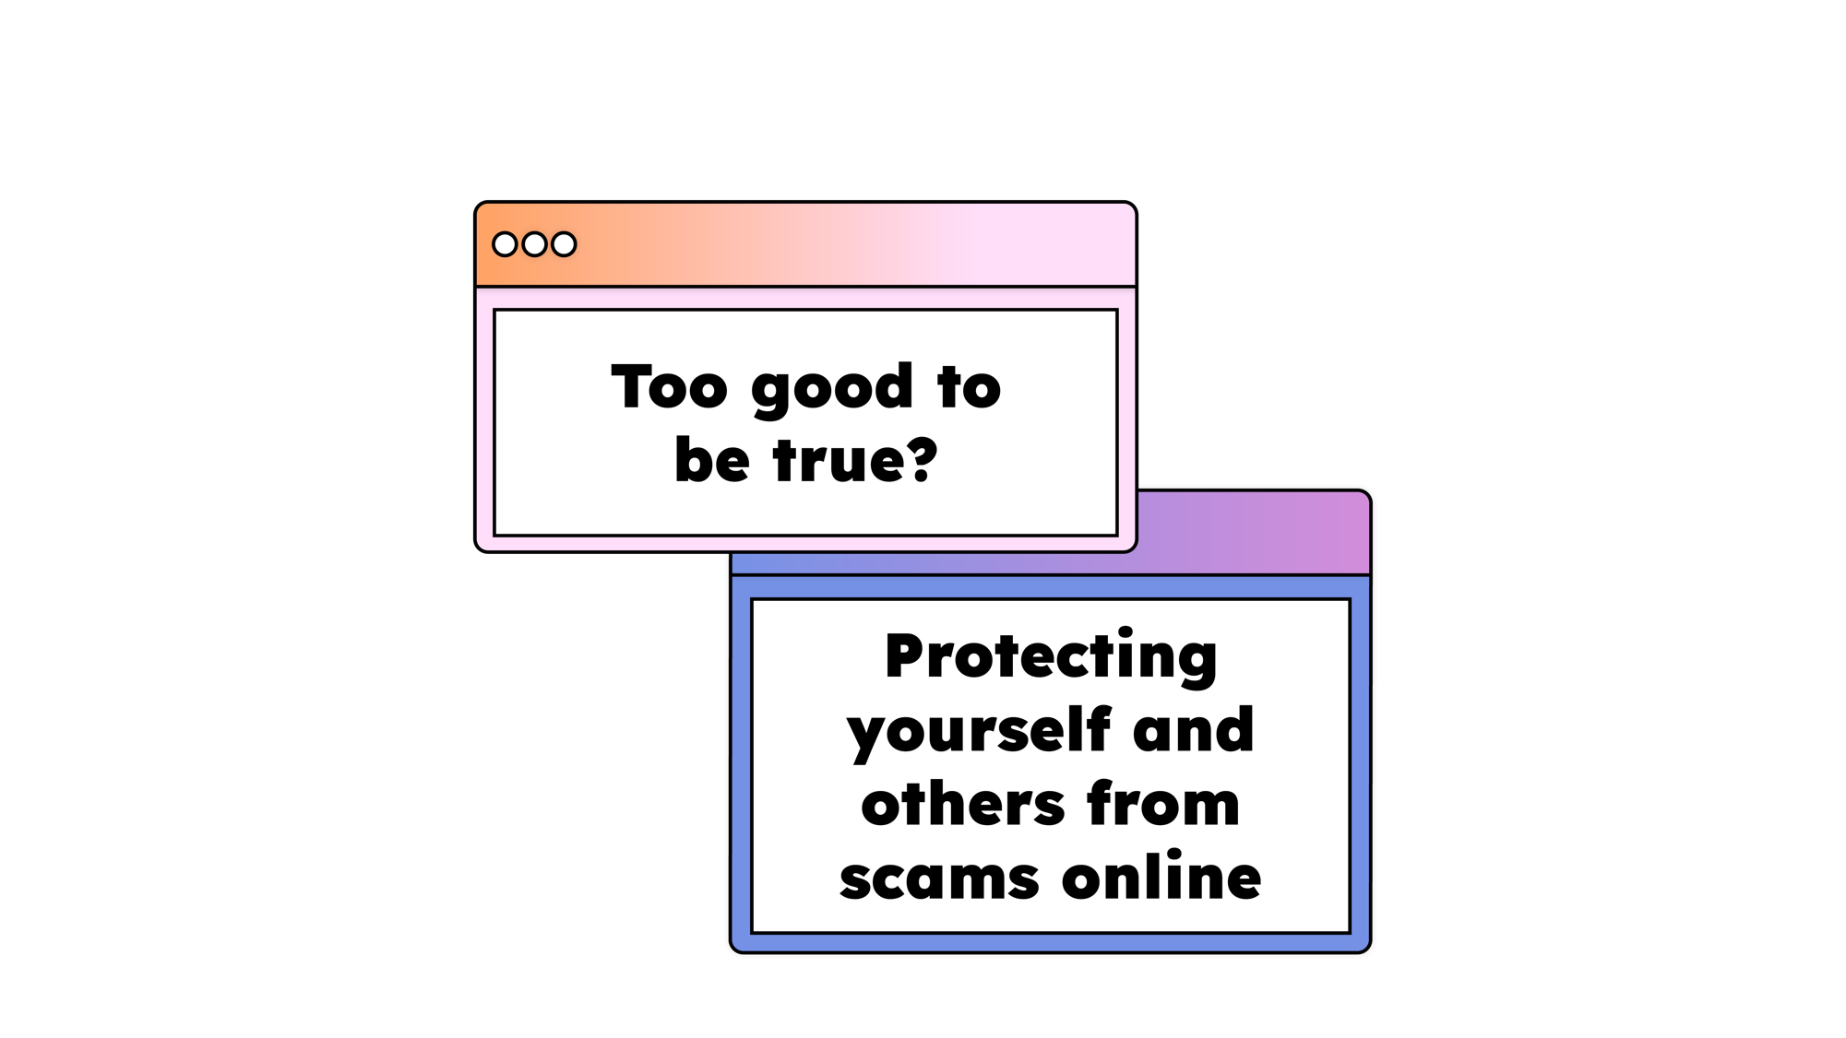
Notes:
This Safer Internet Day lets celebrate the things we love online, but keep our eyes open for possible scams, and always tell a trusted adult if you think you’ve been tricked. Happy Safer Internet Day everyone!

Slide 13


Thank you for Safer Internet Day.
Thank you for everyone who takes care of us and helps to keep us safe online.
Help us to follow the rules and tell others if we feel unsafe in the real world or online.

